Slide 1
Open Source Software
Licensing, Contract, and Copyright Law

Slide 2
The Open Source Definition
The Open Source Definition* begins as follows:
Introduction
Open source doesn’t just mean access to the source code. The distribution terms of open-source software must comply with the following criteria:
1. Free Redistribution
The license shall not restrict any party from selling or giving away the software as a component of an aggregate software distribution containing programs from several different sources. The license shall not require a royalty or other fee for such sale.
Notes:
1. No royalty or other fee imposed upon redistribution.

Slide 3
Contd.
2. Source Code
The program must include source code, and must allow distribution in source code as well as compiled form. Where some form of a product is not distributed with source code, there must be a well-publicized means of obtaining the source code for no more than a reasonable reproduction cost–preferably, downloading via the Internet without charge. The source code must be the preferred form in which a programmer would modify the program. Deliberately obfuscated source code is not allowed. Intermediate forms such as the output of a preprocessor or translator are not allowed.
Notes:
2. Availability of the source code.

Slide 4
Contd.
3. Derived Works
The license must allow modifications and derived works, and must allow them to be distributed under the same terms as the license of the original software.
Notes:
3. Right to create modifications and derivative works.
4. May require modified versions to be distributed as the original version plus patches.

Slide 5
Contd.
4. Integrity of The Author’s Source Code
The license may restrict source-code from being distributed in modified form only if the license allows the distribution of “patch files” with the source code for the purpose of modifying the program at build time. The license must explicitly permit distribution of software built from modified source code. The license may require derived works to carry a different name or version number from the original software.
Notes:
3. Right to create modifications and derivative works.
4. May require modified versions to be distributed as the original version plus patches.

Slide 6
Contd.
5. No Discrimination Against Persons or Groups
The license must not discriminate against any person or group of persons.
6. No Discrimination Against Fields of Endeavor
The license must not restrict anyone from making use of the program in a specific field of endeavor. For example, it may not restrict the program from being used in a business, or from being used for genetic research.

Slide 7
Contd.
7. Distribution of License
The rights attached to the program must apply to all to whom the program is redistributed without the need for execution of an additional license by those parties.
8. License Must Not Be Specific to a Product
The rights attached to the program must not depend on the program’s being part of a particular software distribution. If the program is extracted from that distribution and used or distributed within the terms of the program’s license, all parties to whom the program is redistributed should have the same rights as those that are granted in conjunction with the original software distribution.
Notes:
7. All rights granted must flow through to/with redistributed versions.
8. The license applies to the program as a whole and each of its components.

Slide 8
Contd.
9. The License Must Not Restrict Other Software
The license must not place restrictions on other software that is distributed along with the licensed software. For example, the license must not insist that all other programs distributed on the same medium must be open-source software.
10. The License must be technology-neutral
No provision of the license may be predicated on any individual technology or style of interface.
Notes:
9. The license must not restrict other software, thus permitting the distribution of open source and closed source software together.
10. The license must be technology-neutral; thus no provision of the license may be predicated on any individual technology or style of interface.

Slide 9
The Open Source Definition
No royalty or other fee imposed upon redistribution.
Availability of the source code.
Right to create modifications and derivative works.
May require modified versions to be distributed as the original version plus patches.
No Discrimination Against Persons or Groups
No Discrimination Against Fields of Endeavor
All rights granted must flow through to/with redistributed versions.
The license applies to the program as a whole and each of its components.
The license must not restrict other software, thus permitting the distribution of open source and closed source software together.
The license must be technology-neutral; thus no provision of the license may be predicated on any individual technology or style of interface.

Slide 10
Licensing, Contract, and Copyright Law

Slide 11
Licensing
an act of contract which refers to the transfer of rights by the author partly or wholly at his own terms.
Software license is an agreement between you and the owner of a software program that allows you to do certain things that would otherwise be an infringement of copyright law. The software license usually answers questions such as:
Where and how often can you install the program?
Can you copy, modify, or redistribute it?
Can you look at the underlying source code?
Notes:
The term license means permission. The copyright holder, or licensor, grants another person, known as the licensee, specific permissions to use the work.
Permission by the owner of property to take some act that the owner has the ability to control due to their ownership of intellectual property rights

Slide 12
Intellectual Property (IP)
Definition of Terms
are legally protected rights that one has over new ideas or creations.
Common types of intellectual property include copyrights, trademarks, patents, industrial design rights and trade secrets.
Notes:
What intellectual property rights do you license for software?

Slide 13
Trademark
Definition of Terms
generally a word, phrase, symbol, or design, or a combination thereof, that identifies and distinguishes the source of the goods of one party from those of others

Slide 14
Patent
Definition of Terms
a limited duration property right relating to an invention, granted by the United States Patent and Trademark Office in exchange for public disclosure of the invention
Notes:
an exclusive right to exclude •Making •Using •Selling •Importing

Slide 15
Industrial design right
Definition of Terms
a form of intellectual property right that protects the visual design of objects

Slide 16
Trade secrets
Definition of Terms
a form of intellectual property right which consists of information and can include a formula, pattern, compilation, program, device, method, technique or process.

Slide 17
Contract
a legally binding or valid agreement between two parties
In a shrink-wrap contract, the user is considered to have entered into the contract when the shrink-wrap on the package is torn.
In a click-on or click-wrap contract, a contract dialog box is displayed the very ﬁrst time the application is started.
This dialog box displays an End User License Agreement (EULA). The user is considered to have entered into the contract when the Accept button is clicked.
Notes:
Warranties - a written guarantee, issued to the purchaser of an article by its manufacturer, promising to repair or replace it if necessary within a specified period of time

Slide 18
Copyright
Definition of Terms
gives the creator of the original work exclusive rights in terms of usage, distribution and customization of the work
Notes:
Original works of authorship
Fixed in any tangible medium of expression
Copyright protects only the expression of an idea. The duration of copyright protection depends on several factors. For works created by an individual, protection lasts for the life of the author, plus 70 years. For works created anonymously, pseudonymously, and for hire, protection lasts 95 years from the date of publication or 120 years from the date of creation, whichever is shorter.

Slide 19
Open source software is fundamentally-grounded in copyright law.
Notes:
What do we mean by this when we say fundamentally grounded?

Slide 20
Fundamentals of Copyright Law
In order to appreciate the rights granted under Open Source licenses, one must first be familiar with the basic bundle of rights granted to the holder of a copyright. Under U.S. copyright law, those rights are:
1. The exclusive right to copy the work;
2. The exclusive right to make derivative works;
3. The exclusive right to distribute the work;
4. The exclusive right to perform the work; and
5. The exclusive right to display the work.
Notes:
Copyright gives the creator of the original work exclusive rights in terms of usage, distribution and customization of the work. Some of the privileges copyright provides to the author of software include:
The right to produce and sell copies of the work
The right to create derivative works
The right to sell, transfer or reassign any of the rights granted by copyright to others

Slide 21
These rights, in turn, are subject to certain limitations, such as rights of “fair use.”
Fair use includes the use of a work for purposes of criticism, comment, news reporting, teaching, scholarship or research and does not constitute infringement of the work. Whether a specific use is fair use is determined by a number of factors, including:
(1) the purpose and character of the use, including whether such use is of a commercial nature or is for nonprofit educational purposes;
(2) the nature of the copyrighted work;
(3) the amount and substantiality of the portion used in relation to the copyrighted work as a whole; and
(4) the effect of the use upon the potential market for or value of the copyrighted work.
Notes:
“Fair use” allows persons other than the creator to make certain limited uses of the copyrighted material for purposes of commenting upon or criticizing the work, reporting, or teaching related to the copyrighted material.

Slide 22
The fundamental purpose of open source licensing is to deny anybody the right to exclusively exploit a work.
Notes:
How about this?

Slide 23
Major OSS Licenses and Their Features
OSI has approved more than 50 licenses for Open Source Software.
Apache License 2.0 (Apache-2.0)
Berkeley Software Distribution (BSD) License
BSD 3-Clause "New" or "Revised" license
BSD 2-Clause "Simplified" or "FreeBSD" license
Common Development and Distribution License (CDDL-1.0)
Eclipse Public License (EPL-1.0)
These are examples of OSI--approved licenses that are popular and widely-used or with strong communities:
GNU General Public License (GPL)
GNU Lesser General Public License (LGPL)
MIT license (MIT)
Mozilla Public License 2.0 (MPL-2.0)

Slide 24
Intentions of open source software The main intentions for the OSD are described in the article "Open source licensing, Part 1: The intent" [1] by Martin Streicher and are summarized below.
 | Intention | Explanation
1 | Licensees are free to use open source software for any purpose whatsoever. | This basically means that the licensee need not justify the usage of the open source software
2 | Licensees are free to make copies of open source software and are free to distribute those copies without payment of royalties to a licensor. | This implies that the licensee can redistribute the software at a cost or free of charge.
3 | Licensees are free to create derivative works of open source software and are free to distribute those works without payment of royalties to a licensor. | This allows the licensee to modify the open source software and then redistribute it with or without charge. The licensee is in no way liable to pay any amount to the licensor for this neither can the licensor pose any restrictions on the derivative works. A pre-requisite for intention 3 to occur is the pre-existence of intention 4.
4 | Licensees are free to access and use the source code of open source software. | This means the source code is freely available.
5 | Licensees are free to combine open source and other software. | This gives the licensee the ability to mix open source software with other software.
GNU GPL License
MIT License
BSD License
MPL License
Apache License

Slide 25
The MIT, BSD, Apache, and Academic Free Licenses
These licenses, as applied to the original licensed code, allow that code to be used in proprietary software and do not require that open source versions of the code be distributed. Code created under these licenses, or derived from such code, may go “closed” and developments can be made under that proprietary license, which are lost to the open source community

Slide 26
The MIT (or X) License
Copyright (c) <year> <copyright holders> Permission is hereby granted, free of charge, to any person obtaining a copy of this software and associated documentation files (the “Software”), to deal in the Software without restriction, including without limitation the rights to use, copy, modify, merge, publish, distribute, sublicense, and/or sell copies of the Software, and to permit persons to whom the Software is furnished to do so, subject to the following conditions:
(1) The above copyright notice and this permission notice shall be included in all copies or substantial portions of the Software.
(2) And: THE SOFTWARE IS PROVIDED “AS IS”, WITHOUT WARRANTY OF ANY KIND, EXPRESS OR IMPLIED, INCLUDING BUT NOT LIMITED TO THE WARRANTIES OF MERCHANTABILITY, FITNESS FOR A PARTICULAR PURPOSE AND NONINFRINGEMENT. IN NO EVENT SHALL THE AUTHORS OR COPYRIGHT HOLDERS BE LIABLE FOR ANY CLAIM, DAMAGES OR OTHER LIABILITY, WHETHER IN AN ACTION OF CONTRACT, TORT OR OTHERWISE, ARISING FROM, OUT OF OR IN CONNECTION WITH THE SOFTWARE OR THE USE OR OTHER DEALINGS IN THE SOFTWARE. [all caps in original]

Slide 27
The MIT (or X) License
The phrase “permission is hereby granted, free of charge" clearly indicates that MIT permits licensees to access and use open source software for any purpose whatsoever (Intention 1). Further the phrase "rights to use, copy, modify, merge, publish, distribute, sublicense and/or sell copies" combined with "free of charge" indicates that licensees are free to make and distribute copies, access the source code, create derivative works and combine open source and other software without payment of royalties (Intentions 2, 3, 4 and 5).
An excerpt of the MIT license
Notes:
The MIT License, probably the simplest of those licenses, imposes almost no restrictions on licensees and no meaningful restriction at all on licensees distributing derivative works. When the original work or “substantial portions” of it are distributed, the licensee is required to include a copyright notice and the notice giving permission to potential licensees of their rights to use the work. The licensee is not even required to include the disclaimer of warranties that was part of the original license. (Such licensees may, however, have good reason to include that disclaimer—in particular, to protect themselves from potential liability.) The MIT License does not impose even these restrictions on licensees who choose not to distribute it or “substantial portions” of it, but rather only works derived from it. Such licensees need not include the copyright notice, the disclaimer of warranties, or the permission notice. As described in the previous chapter, this allows the creator of a derivative work to license that new work in any way that he may choose, whether under a proprietary license or under the MIT or another open source license.

Slide 28
The BSD License
Copyright (c) <year> <copyright holders> Permission is hereby granted, free of charge, to any person obtaining a copy of this software and associated documentation files (the “Software”), to deal in the Software without restriction, including without limitation the rights to use, copy, modify, merge, publish, distribute, sublicense, and/or sell copies of the Software, and to permit persons to whom the Software is furnished to do so, subject to the following conditions:
(1) The above copyright notice and this permission notice shall be included in all copies or substantial portions of the Software.
(2) And: THE SOFTWARE IS PROVIDED “AS IS”, WITHOUT WARRANTY OF ANY KIND, EXPRESS OR IMPLIED, INCLUDING BUT NOT LIMITED TO THE WARRANTIES OF MERCHANTABILITY, FITNESS FOR A PARTICULAR PURPOSE AND NONINFRINGEMENT. IN NO EVENT SHALL THE AUTHORS OR COPYRIGHT HOLDERS BE LIABLE FOR ANY CLAIM, DAMAGES OR OTHER LIABILITY, WHETHER IN AN ACTION OF CONTRACT, TORT OR OTHERWISE, ARISING FROM, OUT OF OR IN CONNECTION WITH THE SOFTWARE OR THE USE OR OTHER DEALINGS IN THE SOFTWARE. [all caps in original]
Notes:
Copyright retained
Right to perform
Right to display
Right to modify
Right to distribute

Slide 29
The GPL, LGPL, and Mozilla Licenses
These licenses impose substantial limitations on those who create and distribute derivative works based on works that use these licenses.
Notes:
The licenses described in this chapter are very different from those described in previous slides.
If you’re interested in licenses that keep code from being used in proprietary software:
The GNU General Public License (the GPL License) explicitly requires that derivative works be distributed under the terms of the GPL License and also that derivative works may only be permitted to be distributed under the terms of the license. The Mozilla License imposes different and less restrictive terms on the licensing of derivative works

Slide 30
GNU General Public License
One of the foundation open source licenses
Created by the Free Software Foundation (FSF)

Slide 31
GNU General Public License (GPL)
An excerpt of the GNU license
The sentence "You may modify your copy or copies of the Program or any portion of it, thus forming a work based on the Program, and copy and distribute such modifications or work" indicates that licensees are free to access, and use open source software for any purpose and that they are free to create and distribute derivative works (Intention 1, 3, 4 and 5). In the same sentence, the clause "copy and distribute such modifications or work" further indicates that licensees are free to make copies of the open source software (Intention 2).
Notes:
The GNU’s General Public License, or GPL, is one of the foundation open source licenses. Created by the Free Software Foundation (FSF), which has made many contributions to open source coding, it is the preferred license for projects authorized by the FSF, including the GNU Emacs Editor and the GNU C Compiler, among literally scores of others, including the GNU/Linux kernel.
The intentions behind the license and the premise underlying it are explained in the license’s preamble, which is included here in its entirety. The preamble follows the copyright notice,† and a notice that prevents modifications, ironically enough, to the license itself: “Everyone is permitted to copy and distribute verbatim copies of this license document, but changing it is not allowed.” While the license permits the creation of derivative works from the licensed code, it does not permit the creation of derivative licenses from the license itself.

Slide 32
GNU Lesser General Public License (LGPL)
The LGPL provides an alternative license that preserves many of the benefits of the GPL model for such libraries—in fact, the Lesser General Public License was in its first incarnation known as the Library General Public License. LGPL-licensed libraries can be linked with non-GPL licensed programs, including proprietary software. However, libraries need not be licensed under the LGPL, and as the following preamble to the license points out, the preferable way to license libraries, at least under some circumstances, is under the GPL.

Slide 33
Types of Open Source Licenses
Restrictive (aka Copyleft, reciprocal)
Permissive

Slide 34
Types of Open Source Licenses
1. Restrictive (aka Copyleft, reciprocal)
Requires licensor to make improvements or enhancements available under similar terms
• Licenses establish a specific trigger for sharing obligation
• Example is the GPLv2: Licensee must distribute “work based on the program” and cause such works to be licensed at no charge under the terms of the GPL

Slide 35
Types of Open Source Licenses
2. Permissive
Modifications/enhancements may remain proprietary
• Distribution in source code or object code permitted provided copyright notice & liability disclaimer are included and contributors’ names are not used to endorse products
• Examples: Berkeley Software Distribution (BSD), Apache Software License

Slide 36
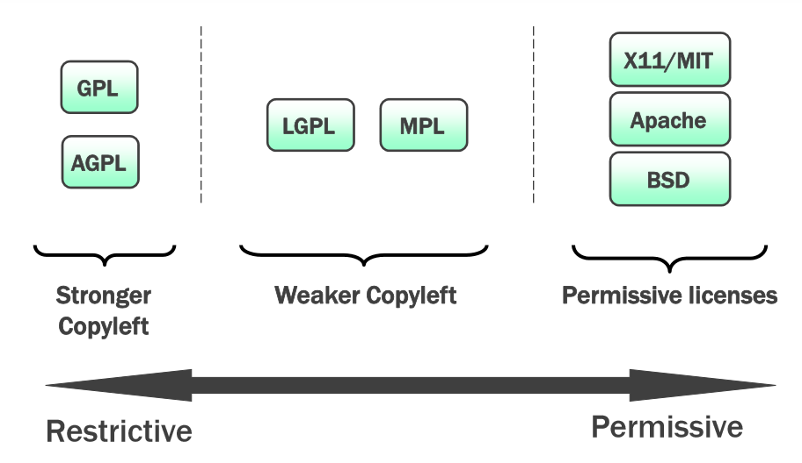

Slide 37
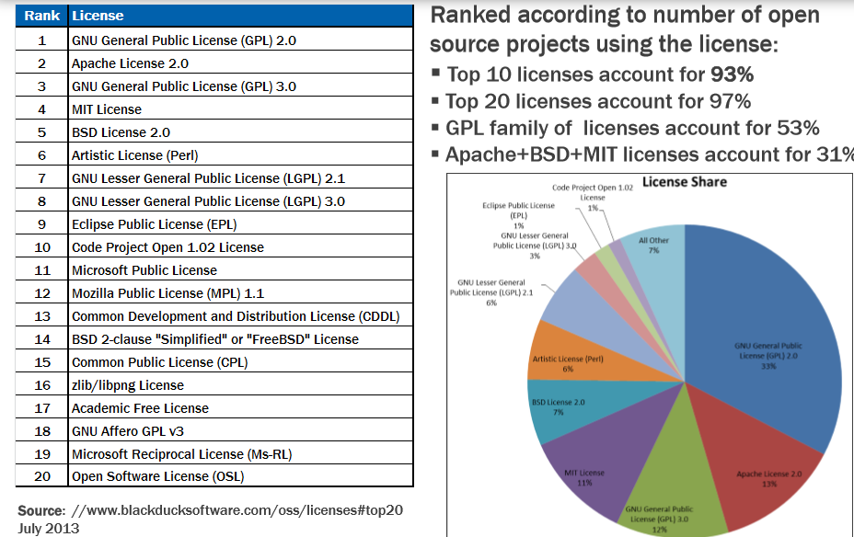

Slide 38
https://opensource.org/licenses/category
Special purpose licenses
Other/Miscellaneous licenses
Licenses that are redundant with more popular licenses

